Slide 1


Assignment 01 Machine Learning Tutorial
Name : Agha Saud Khan
ID : 23083162
GIT : https://github.com/aghasaud1996/Machine-learning-clustering-tutorial

Slide 2
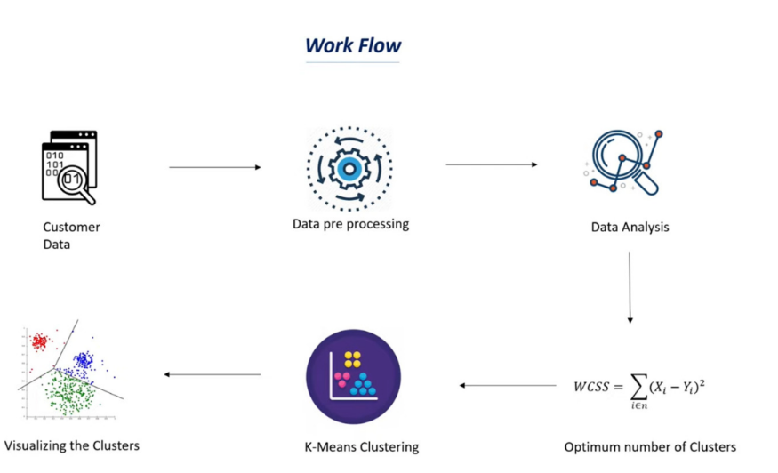
Unsupervised Learning
INTRODUCTION
Clustering
K-MEANS CLUSTERING
Elbow Method
Silhouette Method

Slide 3
Introduction
Unsupervised learning is a type of machine learning where the algorithm is given data without any labels or predefined categories. The goal is to let the model discover hidden patterns, structures, or groupings on its own.
A good example of unsupervised learning is clustering, where similar data points are grouped together based on features like behavior, characteristics, or similarity.

Slide 4
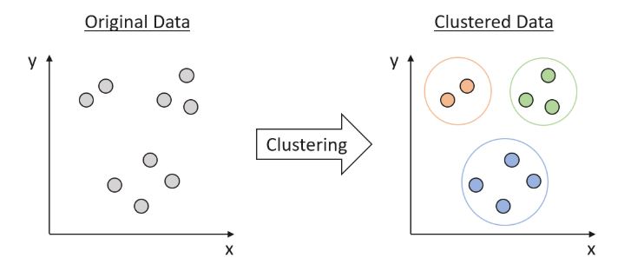
Clustering
Type of unsupervised learning
Data is not labeled
Find subset of data which behave is similar way
Similar to that group/ dissimilar to other group

Slide 5
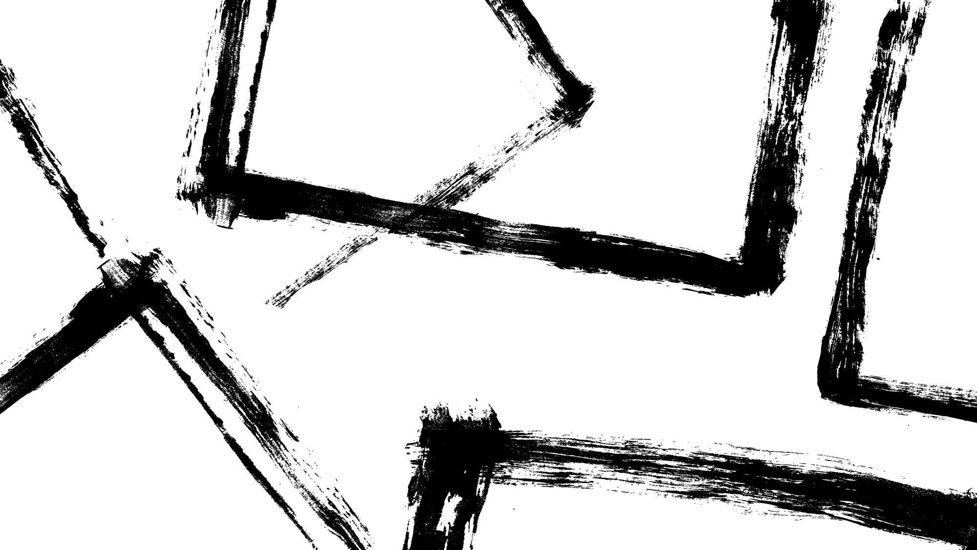
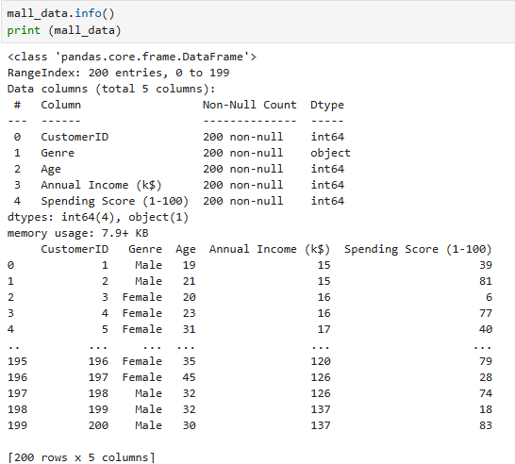
Customer Dataset Overview
We will be taking information about mall customers to explain method of clustering in this lecture.
The data set contains 5 columns.
Customer ID
Genre
Age
Annual Income
Spending Score

Slide 6
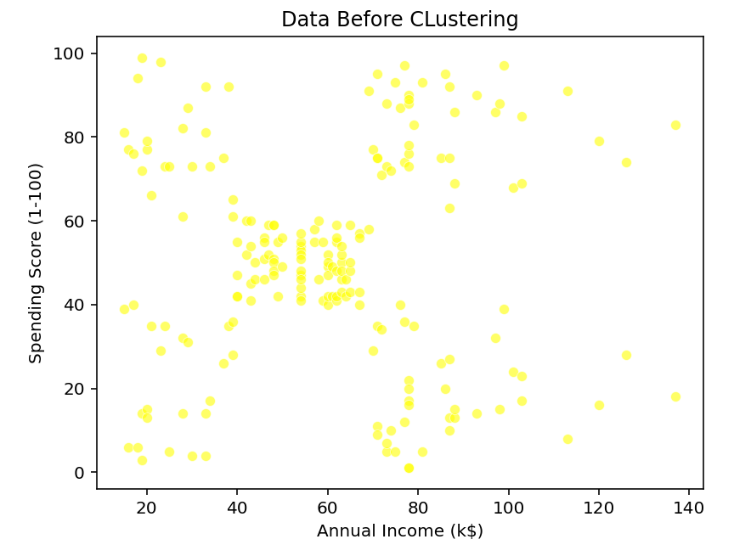
Visualizing Customer Data

Slide 7
K-Means Clustering
K-Means Clustering is a popular unsupervised machine learning algorithm used to group data points into K distinct clusters based on similarity.
The main goal of K-Means is to group data into clusters where items in the same cluster are very similar, and items in different clusters are quite different.
Each item belongs to only one cluster, and the algorithm creates a set number of separate, non-overlapping groups.

Slide 8
Challenges for K-Means Clustering
K-Means requires you to choose the number of clusters in advance.
K-Means doesn’t perform well with clusters of different sizes, shapes, or densities.
Outliers can distort the results of K-Means.

Slide 9
Silhouette Method
The Silhouette Method helps evaluate how well data points fit within their assigned clusters.
It compares how close a point is to its own cluster vs. the nearest neighboring cluster.
Each point gets a score between -1 and 1.
The higher the average silhouette score, the better the overall clustering.
It helps determine the optimal number of clusters (K) by comparing scores across different values of K.

Slide 10
Silhouette Formula
Silhouette Score Formula:
Silhouette Score = b−a​/ max(a,b)
a = Average distance to all other points in the same cluster
b = Average distance to points in the nearest neighbor cluster
+1 → well assigned to its cluster
0 → on the border between clusters
-1 → likely in the wrong cluster

Slide 11
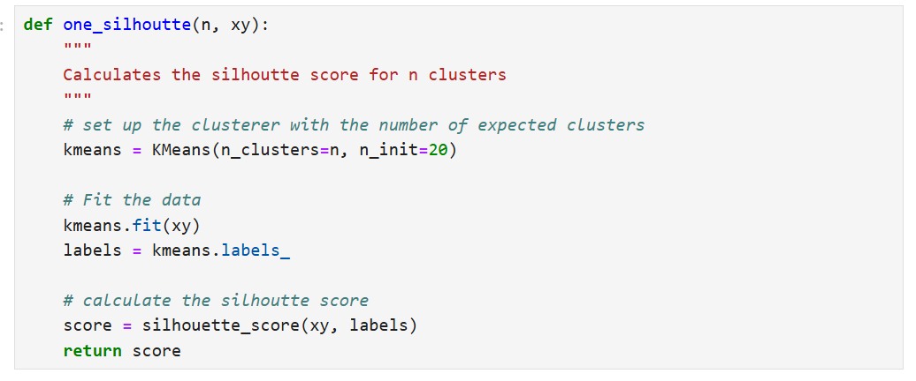
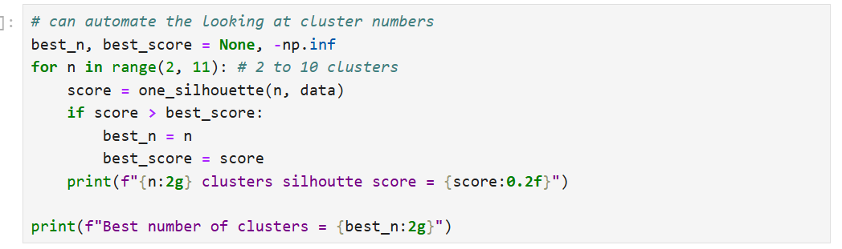
Silhouette Code

Slide 12
Elbow Method
The Elbow Method helps you find the best number of clusters for K-Means.
It works by plotting the total error (within-cluster distance) for different numbers of clusters.
The best number of clusters is usually where the curve suddenly stops dropping sharply and forms a bend like an elbow.

Slide 13
Working of Elbow Method
You run K-Means with different values of K (for example, from 1 to 10).
For each K, calculate the within-cluster sum of squares (WCSS) and this tells you how tightly the points in each cluster are grouped.
Plot K vs. WCSS on a graph.
As K increases, WCSS decreases but at some point, the rate of decrease slows down.
The point where the curve bends like an elbow is the optimal number of clusters.

Slide 14
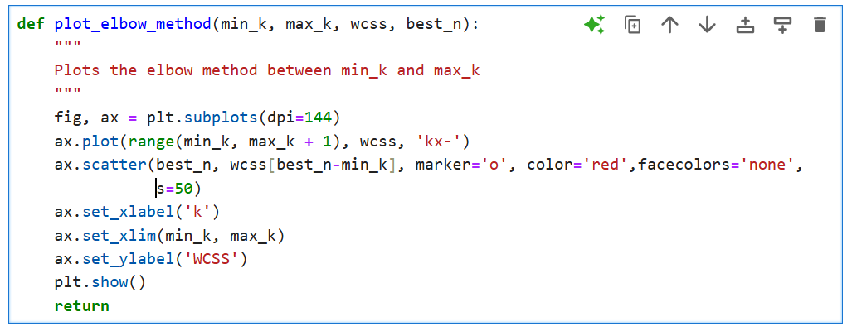
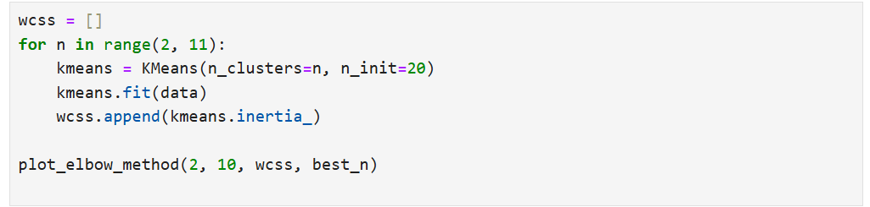
Elbow Method Code

Slide 15
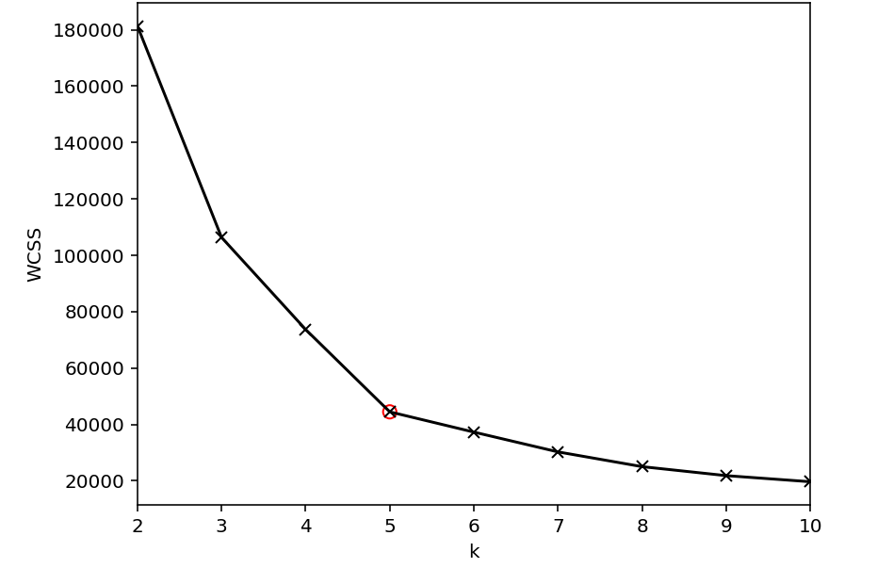
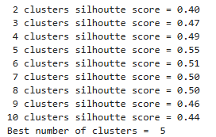
Outputs for value of K
Elbow Method
Silhouette Method

Slide 16
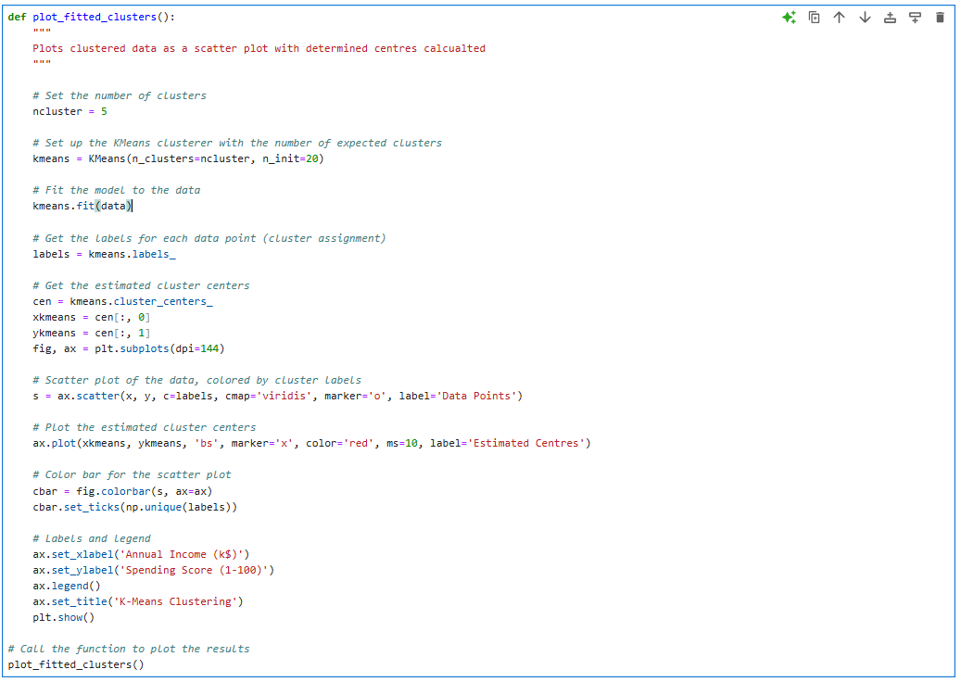
Code For KNN Visualizing

Slide 17
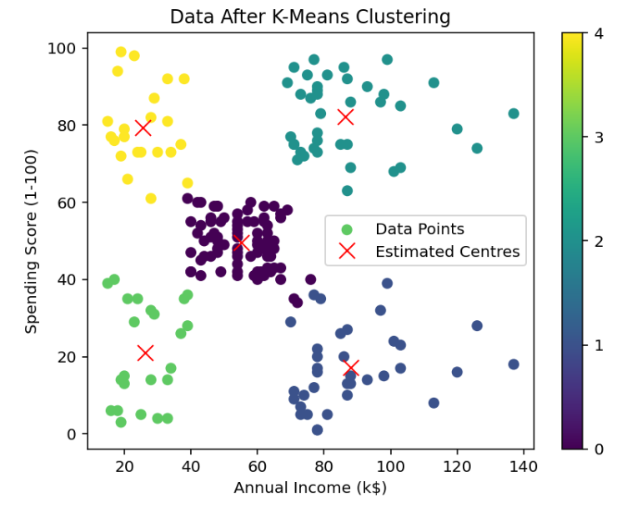
Visualizing Data After Clustering

Slide 18
Conslusion
Cluster Centers: Each cluster's center point is represented by the red "X" marks.
Green Cluster: The Green cluster on the plot shows customers with less income(20-40) but high spending scores(70-100).
Yellow Cluster: The yellow cluster on the plot shows high-income(80-140) and high-spending customers(60-100).
Purple Cluster: The purple cluster in the plot shows customers with low income(40-60) and equal spending scores(40-60).
Blue Cluster: The blue cluster in plot shows customers having low incomes(20-40) and low spending behaviors(5-40).
Teal Cluster: Represents individuals with high income(70-140) but less spending scores(5-40)
The K-Means Clustering results clearly split people into five different groups according to their annual income and spending patterns. From low-income, low-spending groups to high-income, high-spending people. this clustering technique provides useful information for the use of resources, personalized product offerings, and targeted marketing, ensuring that business strategies suit the specific needs and habits of each customer type.

Slide 19
References
https://www.geeksforgeeks.org/clustering-in-machine-learning/
https://ukdataservice.ac.uk/app/uploads/mlclustering2022-10-26.pdf
https://www.datacamp.com/blog/clustering-in-machine-learning-5-essential-clustering-algorithms
https://waterprogramming.wordpress.com/2022/03/16/clustering-basics-and-a-demonstration-in-clustering-infrastructure-pathways/
https://www.analyticsvidhya.com/blog/2019/08/comprehensive-guide-k-means-clustering/
https://www.geeksforgeeks.org/elbow-method-for-optimal-value-of-k-in-kmeans/
https://www.kaggle.com/datasets/shwetabh123/mall-customers?resource=download

